Slide 1
Divisibility tests for 4 and 8
Properties of number: factors, multiples, squares and cubes

Slide 2
how to use Oak lessons

Slide 3
I can identify and explain whether a number is or is not a multiple of a given integer.

Slide 4
Divisibility is a mathematical concept that refers to one number's ability to be exactly divided by another, leaving no remainder.
Example
Non example
Divisibility test for 2 : The digit in the ones column is a 0, 2, 4, 6 or 8.
794
9351

Slide 5

Divisibility tests for 4 and 8
Divisibility tests for 4
Divisibility tests for 8

Slide 6
Divisibility tests for 4
Divisibility test for 2 : The digit in the ones column is a 0, 2, 4, 6 or 8
Given 4 is a multiple of 2, does this mean all multiples of 4 are also all multiples of 2?
List the first ten multiples of 4 :
List the first ten multiples of 2 :
4, 8, 12, 16, 20, 24, 28, 32, 36, 40
2, 4, 6, 8, 10, 12, 14, 16, 18, 20,
Yes, because 4 is a multiple of 2.

Slide 7
Divisibility tests for 4
Given 4 is a multiple of 2, does this mean all multiples of 2 are also all multiples of 4?
List the first ten multiples of 4 :
List the first ten multiples of 2 :
4, 8, 12, 16, 20, 24, 28, 32, 36, 40
2, 4, 6, 8, 10, 12, 14, 16, 18, 20,
No, because 2 is not a multiple of 4.

Slide 8
Divisibility tests for 4
Divisibility test for 4
4
8
12
16
20
24
28
32
36
40
44
48
52
56
60
64
68
72
76
80
84
88
92
96
100
What pattern do you notice?

Slide 9
Divisibility tests for 4
Divisibility test for 4
Can you figure out a divisibility test for 4 using 38 834 864?
4
8
12
16
20
24
28
32
36
40
44
48
52
56
60
64
68
72
76
80
84
88
92
96
100
Because 4 is a factor of 100, this means we know 4 is a factor of 38 834 800, so we only need to look to see if the last two digits are a factor
100
Yes 38 834 864 is a multiple of 4

Slide 10
Divisibility tests for 4
Divisibility test for 4
The divisibility test for 4 states that a number is a multiple of 4 if the last two digits are a multiple of 4.
4
8
12
16
20
24
28
32
36
40
44
48
52
56
60
64
68
72
76
80
84
88
92
96
100

Slide 11

Divisibility tests for 4
Which of the following is a multiple of 4? There can be more than one answer. Justify your answer.
The last two digits are 32 and 32 is a multiple of 4
The last two digits are 24 and 24 is a multiple of 4
The last two digits are 08 and 8 is a multiple of 4
44 898 434
378 432
5 984 438 424
389 308

Slide 12


Divisibility tests for 4
Three trucks transport fruit to supermarkets. Fruit is sold in multiples of 4. One truck lost 6 pieces of fruit. Which truck lost the fruit? Explain your answer.
8384 pieces of fruit
9162 pieces of fruit
7228 pieces of fruit
Not a multiple of 4

Slide 13
Divisibility tests for 4
1) Identify the multiples of 4 from the lists:
378, 8940, 93 424, 9288
32 980, 8 430 348, 3 490 085, 2 222 222
2) Identify the multiples of 4 and 5 from the list below:
92 980, 4 300 360, 3 490 085, 2 222 440

Slide 14
Divisibility tests for 4
3) Identify if the statements are sometimes, always or never true.
Statement | Sometimes | Always | Never
A multiple of 4 is a multiple of 2
A multiple of 2 is a multiple of 4
A multiple of 10 is a multiple of 2
A multiple of 9 is a multiple of 3
A multiple of 8 is odd
Multiples of 40 are multiples of 5, 8 and 10

Slide 15
Divisibility tests for 4
1) Identify the multiples of 4 from the lists:
378, 8940, 93 424, 9288
32 980, 8 430 348, 3 490 085, 2 222 222
2) Identify the multiples of 4 and 5 from the list below:
92 980, 4 300 360, 3 490 085, 2 222 440

Slide 16
Divisibility tests for 4
3) Identify if the statements are sometimes, always or never true.
Statement | Sometimes | Always | Never
A multiple of 4 is a multiple of 2
A multiple of 2 is a multiple of 4
A multiple of 10 is a multiple of 2
A multiple of 9 is a multiple of 3
A multiple of 8 is odd
Multiples of 40 are multiples of 5, 8 and 10

Slide 17
Divisibility tests for 4 and 8
Divisibility tests for 4
Divisibility tests for 8

Slide 18
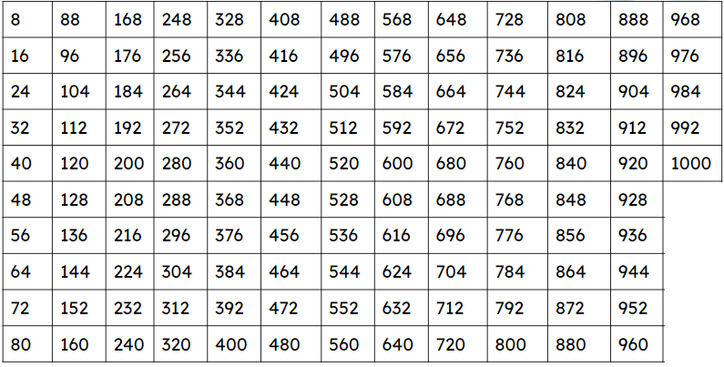
Divisibility tests for 8
The divisibility test for 4 works when the last two digits are divisible by 4 because 100 is a multiple of 4. However, 100 is not a multiple of 8. How do you think we might test for divisibility by 8?

Slide 19
Divisibility tests for 8
8 is a factor of 1000, therefore if the last three digits of a number is a multiple of 8 then we know the number is divisible by 8.
Example
Example
Non example
7160
138 293 144
293 666
160 is a multiple of 8
144 is a multiple of 8
666 is not a multiple of 8

Slide 20
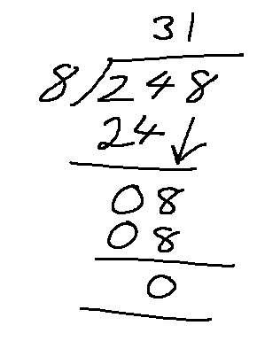
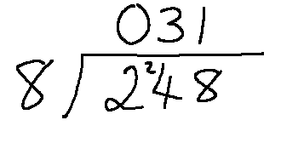
Divisibility tests for 8
Which of the following shows 385 248 is divisible by 8?
Jun says
“I know my 8 times table and I know 248 is a multiple of 8 so 385 248 is divisible by 8.”
Andeep did this working out.
It shows the last three digits are divisible by 8 so 385 248 is divisible by 8.
Alex did this.
The last three digits are divisible by 8 so 385 248 is divisible by 8.

Slide 21
Divisibility tests for 8
Aisha uses a partitioning method to check if 385 248 is divisible by 8.
Focussing on the last 3 digits she has
8 is a factor of 200, 40 and 8 so therefore 385 248 is a multiple of 8.
248
200 + 40 + 8
8 × 50
8 × 1
8
8 × 5
8
8

Slide 22
Divisibility tests for 8
Which of the following is a multiple of 8?
Using partitioning
360
89 438 348
+
789 483 839 360
300
60
160 + 160 + 40
8 × 5
8 × 20
8 × 20
8
8
8
8 is a factor of 160 and 40 so therefore 789 483 839 360 is a multiple of 8.
475 498

Slide 23
1) Circle all the multiples of 8
4839 38 409 3284 84 032
4384 11 902 20 484 56 870 888
80 000 000 000
Divisibility tests for 8
2) All the multiples of 2 and 3 are multiples of 6.
All the multiples of 3 and 5 are multiples of 15.
Explain why all the multiples of 2 and 8 are not all multiples 16.

Slide 24
Divisibility tests for 8
3) Fill in the missing information. Some have been done for you.
1 2 5 8 16 20 40 45 80
100 160 165 29 213 9000
Multiples of ?
Multiples of ?
__
__
__
__
__
__
160
__
__
__
__
__
__

Slide 25
Divisibility tests for 8
4) You are playing a board game. A multiple of 5 can move 2 right. A multiple of 3 can move 3 up. A multiple of 8 can move 4 left. A multiple of 11 can move 1 left or right. a) Which starting number do you choose?
b) Draw your path to win the game in as few moves as possible.
11 | 11 | 88 | 55 | 88 | EXIT
99 | 33 | 66 | 11 | 4 | 33
44 | 99 | 66 | 66 | 8 | 66
125 | 100 | 455 | 10 | 639 | 99
17 | 66 | 33 | 22 | 22 | 55
23 | 66 | 44 | 77 | 55 | 100
333 | 26 | 13 | 11 | 440 | 77
c) Design your own game using multiples of 2, 3, 4, 6, 8, 9 or 10
Start 1
Start 2
Start 3

Slide 26
1) Circle all the multiples of 8
4839 38 409 3284 84 032
4384 11 902 20 484 56 870 888
80 000 000 000
Divisibility tests for 8
2) All the multiples of 2 and 3 are multiples of 6.
All the multiples of 3 and 5 are multiples of 15.
Explain why all the multiples of 2 and 8 are not all multiples of 16.
2 is a factor of 8 so this means all multiples of 2 and 8 are multiples of 8. For example, 8 is a multiple of 2 and 8 but 8 is not a multiple of 16.

Slide 27
Divisibility tests for 8
3) Fill in the missing information. Some have been done for you.
1 2 5 8 16 20 40 45 80
100 160 165 29 213 9000
Multiples of
Multiples of
5
8
__
__
165
8
__
40
__
__
45
100
80
20
__
__
__
__
160
16
__
5
9000
__
__
1
2
__
29 213
__
________

Slide 28
Divisibility tests for 8
4) You are playing a board game. A multiple of 5 can move 2 right. A multiple of 3 can move 3 up. A multiple of 8 can move 4 left. A multiple of 11 can move 1 left or right. a) Which starting number do you choose?
b) Draw your path to win the game in as few moves as possible.
11 | 11 | 88 | 55 | 88 | EXIT
99 | 33 | 66 | 11 | 4 | 33
44 | 99 | 66 | 66 | 8 | 66
125 | 100 | 455 | 10 | 639 | 99
17 | 66 | 33 | 22 | 22 | 55
23 | 66 | 44 | 77 | 55 | 100
333 | 26 | 13 | 11 | 440 | 77
11 | 11 | 88 | 55 | 88 | EXIT
99 | 33 | 66 | 11 | 4 | 33
44 | 99 | 66 | 66 | 8 | 66
125 | 100 | 455 | 10 | 639 | 99
17 | 66 | 33 | 22 | 22 | 55
23 | 66 | 44 | 77 | 55 | 100
333 | 26 | 13 | 11 | 440 | 77
Start 3
c) Design your own game using multiples of 2, 3, 4, 6, 8, 9 or 10
Start 1
Start 2
Start 3

Slide 29
Divisibility tests for 4 and 8
Divisibility tests are quick processes to identify if a number is divisible.
A number is divisible by 4 if the last two digits are a multiple of 4. This is because we know 4 is a factor of 100.
A number is divisible by 8 if the last three digits are a multiple of 8. This is because we know 8 is a factor of 1000.

Slide 30

© Oak National Academy 2023.
Produced in partnership with Mathematics in Education and Industry.
Licensed on the Open Government Licence v3.0, except where otherwise stated. See Oak terms and conditions.

